Slide 1
Channel Bonding analysis on 802.11n
Tsourdinis theodoros 2303
Notes:
<number>

Slide 2
Assigned Paper…
“The impact of channel bonding in 802.11n Network Management”
Introduction to channel bonding concept and its origin
How the MIMO technology makes it efficient?
What are the characteristics of channel bonding in 802.11n networks?
How can the network performance be maximized?
How is this work different than all the previous?
Notes:
<number>

Slide 3
How are all of these tested?
General Scenario: 2 Links - SUT (System under Test) and Interference Link
Experimental Band: 5GHz
Various MCS
Special sub-scenarios
Coming up next…
Notes:
<number>

Slide 4
1st Scenario – The SUT operates with 40 MHz width without interference
Tested with fixed and auto MCS
Based on optimization factors (throughput, packet loss) – Best MCS index : 145, Highest Throughput : 261 Mb/s (link1_40mhz_145.txt)
2nd Scenario – The two links share the same channel
Both with channel bonding
One on channel bonding, the other with 20 MHz width
Both with 20 MHz width
Conclusion: The best case is to have the 2.1 scenario (why?)
Notes:
<number>

Slide 5
3rd Scenario – Two links operate on adjacent channels
Both with channel bonding
One on channel bonding, the other with 20 MHz width
Both with 20 MHz width
Conclusion: Again, the best case is to have the 3.1 scenario (why?)
4th Scenario – The two links operate on channels “far” one from the other
Both with channel bonding
One on channel bonding, the other with 20 MHz width
Both with 20 MHz width
Conclusion: The best case is to have the 4.1 scenario (why?)
Notes:
<number>

Slide 6
How we did that?
Challenge: We had to disable the CCA metric (why?) and configure the ath9k driver to operate on 5 GHz.
We modified the hostapd source code
We used NITLAB’s recourses, nodes that have chipset compatible with 802.11n and duty cycle graphs
We used iperf command to take measurements
We disabled the ath9k auto rate selection
Notes:
<number>

Slide 7
General Observations
If interferer – 20MHz adjacent, C.B. degrades performance
If interferer – 40MHz adjacent, C.B. improves performance
If interferer – separated by 20MHz, C.B. always improves performance
Our findings show that it is more advantageous for SUT to compete for the channel with an interferer who transmits at 40MHz.
Notes:
<number>

Slide 8
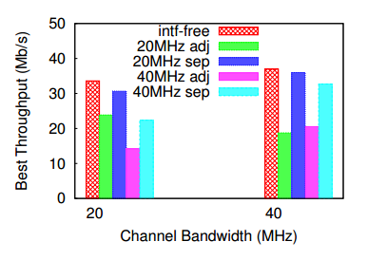

Slide 9
Extra Task – Interferer Sliding on 2.4 GHz
Scenario: The SUT was permanently transmitting on channel 1 while the interferer was sliding through the spectrum.
Cases:
SUT – 20MHz, Interferer – 20MHz
SUT – 20MHz, Interferer – 40MHz
SUT – 40MHz, Interferer – 20MHz
SUT – 40MHz, Interferer – 40MHz
Notes:
<number>

Slide 10
Observations for 2.4GHz band experiments
2.4GHz band has a limited number of channels and suffers from interference from commonly used consumer products operating at the same frequency.
The overall performance of channel bonding is significantly worse in the 2.4GHz band (much lower throughput).
These observations are proven both by the duty cycle measurements and by the iperf logs. It is obvious, that the spectrum is much more occupied and not friendly for channel bonding.
Notes:
<number>

Slide 11
Thank you for your attention!

